Slide 1
Chapter 4: Essential Number Theory and Discrete Math

Slide 2
Number Systems
Natural numbers: Many sources count only the positive integers (1, 2, 3, 4,…) without including 0. Other sources include 0. In either case, these are the numbers that correspond to counting.
Integers: The counting numbers plus negative numbers: –2, –1, 0, 1, 2, and so on.
Rational numbers: Any number that can be expressed as the quotient of two integers: 1/3, 1/2, 3/4, 5/6, and so on.

Slide 3
Number Systems
Irrational numbers: A number that cannot be expressed as the quotient of two integers. Some are repeating some are not.
A good example is pi: 3.14159…
Real numbers: The superset of all rational numbers and all irrational numbers.
Imaginary numbers: Begin with square root of negatives, such as √–1 = i.

Slide 4
Prime Numbers
A prime number is divisible by itself and 1:
  2, 3, 5, 7, 11, 13, 17, 23, and so on

Slide 5
Mersenne Primes
Marin Mersenne (1588 to 1648) was a French theologian who made significant contributions to acoustics and music theory as well as mathematics. Mersenne believed that the formula 2^{p} – 1 would produce prime numbers.
Investigation has shown that this formula will produce prime numbers for p = 2, 3, 5, 7, 13, 17, 19, 31, 67, 127, 257, but not for many other numbers such as p = 4, 6, 8, 9,10, 11, and so on.
His conjecture resulted in a prime of the form 2^{p} – 1 being named a Mersenne prime. By 1996, there were 34 known Mersenne primes, with the last eight discoveries made on supercomputers.

Slide 6

Fermat Prime
Pierre de Fermat, a mathematician of the 17th century, made many significant contributions to number theory. He also proposed a formula that he thought could be used to generate prime numbers. He believed that numbers of the following format were prime numbers:
Several such numbers, particularly the first few powers of 2, are indeed prime, as you can see here:
  2¹ + 1 = 3 prime
  2² + 1 = 5 prime
  2⁴ + 1 = 17 prime
  2⁸ + 1 = 257 prime
  2¹⁶ + 1 = 65537 prime
Unfortunately, just like Mersenne primes, not all Fermat numbers are prime.

Slide 7
Lucas-Lehmer test
This test is designed to determine whether a given number n is a prime number. It is a deterministic test of primality that works on Mersenne numbers. That means it is effective only for determining whether a given Mersenne number is prime. Remember that a Mersenne number is in the form 2^{p} – 1.
In the 1800s, French mathematician Edouard Lucas developed a primality test. In the early 20th century, American mathematician Derrick Lehmer provided a proof of this test. The test is now called the Lucas-Lehmer test.

Slide 8
Relatively Prime
Two numbers x and y are relatively prime (co-prime) if they have no common divisors other than 1. So, for example, the numbers 8 and 15 are co-prime. The factors of 8 are 1, 2, and 4. The factors of 15 are 1, 3, and 5. Since these two numbers (8 and 15) have no common factors other than 1, they are relatively prime.
The term for the integers that are smaller than n and have no common factors with n (other than 1) is totative. For example, 8 is a totative of 15.
Another term for Euler’s totient is the Euler phi function.

Slide 9
Relatively Prime
What if a given integer, n, is a prime number? How many totatives will it have (that is, what is the totient of n)?
Let’s take a prime number as an example, 7. Given that it is prime, we know that none of the numbers smaller than 7 have any common factors with it. So 2, 3, 4, 5, and 6 are all totatives of 7. And since 1 is a special case, it is also a totative of 7, so we find there are six numbers that are totatives of 7.
It turns out that for any n that is prime, the Euler’s totient of n is n – 1. So if n = 13, then the totient of n is 12.

Slide 10
Divisibility Theorems
if a | b and a | c, then a | (b + c)
    Example: 3 | 6 and 3 | 9, then 3 | 15
if a | b, then a | bc for all integers c
    Example: 5 | 10, then 5 | 20, 5 | 30, 5 | 40, …
if a | b and b | c, then a | c
    Example: 4 | 8 and 8 | 24, then 4 | 24

Slide 11
Summation
You have probably seen the summation symbol: ∑
If not, you will see it later in this book.
It is basically a way of adding a sequence of numbers to get their sum. Any intermediate result at any given point in the sequence is a partial sum (sometimes called a running total or prefix sum).
The numbers that are to be added up are often called addends or sometimes summands. They can be any numbers, but in cryptography we will most often be interested in summing integers.

Slide 12
Logarithms
The logarithm of a number is the exponent to which some fixed value (called the base) must be raised to produce that number.
Let’s assume base 10 and ask, what is the logarithm of 10,000?
What number must 10 be raised to in order to produce the number 10,000?
The answer is 4: 10⁴ = 10,000

Slide 13
Natural Logarithms
Natural logarithms use the irrational number e (approximately 2.718) as the base.
The natural logarithm of some number x is usually written as ln x, but can be written as log_{e} x.
As with any logarithm, the natural log is what power e must be raised to in order to give some particular number.

Slide 14
Discrete Logarithms
To understand discrete logarithms, keep in mind the definition of a logarithm: it is the number to which some base must be raised to get another number. Discrete logarithms ask this same question but do so in regard to a finite group.
Put more formally, a discrete logarithm is some integer k that solves the equation x^{k} = y, where both x and y are elements of a finite group.
Computing a discrete logarithm is a difficult problem, which is why discrete logarithms form the basis for some modern cryptographic algorithms.

Slide 15
Modulus
Let’s begin with the most simple explanation, and then later delve into more details.
To use the modulus operator, simply divide A by N and return the remainder.
So 5 mod 2 = 1
So 12 mod 5 = 2
This explains how to use the modulus operator, and in many cases this is as far as many programming textbooks go.

Slide 16
Modulus
One way to think about modulus arithmetic is to imagine doing any integer math you might normally do, but bound your answers by some number. A classic example is the clock. It has numbers 1 through 12, so any arithmetic operation you do has to have an answer that is 12 or less. If it is currently 4 o’clock and I ask you to meet me in 10 hours, simple math would say I am asking you to meet me at 14 o’clock. But that is not possible, because our clock is bounded by the number 12. The answer is simple: take your answer and use the mod operator with a modulus of 12 and look at the remainder:
  14 mod 12 = 2
So I am asking you to meet me at 2 o’clock (whether that is a.m. or p.m. depends on the original 4 o’clock, but that is irrelevant to understanding the concepts of modular arithmetic). This is an example of how you use modular arithmetic every day.

Slide 17
Congruence
Congruence in modulus operations is a very important topic, and you will see it applied frequently in modern cryptographic algorithms.
Two numbers, a and b, are said to be “congruent modulo n” if
(a mod n) = (b mod n) —> a ≡ b(mod n)

Slide 18
Fibonacci
Italian mathematician Leonardo Bonacci (also known as Fibonacci) (1170 to 1250) made significant contributions to mathematics. He is most famous for the Fibonacci numbers.
Fibonacci numbers represent an interesting sequence of numbers:
1, 1, 2, 3, 5, 8, 13, 21, and so on.
The sequence is derived from adding the two previous numbers. To put that in a more mathematical format:
  Fn = Fn – 1 + Fn – 2
So, in our example, we see that 2 is 1 + 1, 3 is 2 +1, 5 is 3 + 2,
8 is 5 + 3, and so on.

Slide 19
Fermat
Pierre de Fermat lived in the first half of the 17th century. He was trained as a lawyer and was an amateur mathematician, though he made significant contributions to mathematics. He did work in analytical geometry and probability but is probably best known for several theorems in number theory, which is covered here briefly.
Fermat’s little theorem states that if p is a prime number, then for any integer a, the number a^{p} − a is an integer multiple of p.
What does this mean? Here’s an example. Suppose a = 2 and p = 5. This gives us 2⁵ or 32. 32 – 2 is 30, which is indeed a multiple of p (5).
This actually turns into a primality test. If you think p is a prime number, you can test it. If it is prime, then a^{p - a} should be an integer multiple of p. If it is not an integer multiple of p, then p is not prime..

Slide 20
Euler
Leonhard Euler is an important figure in the history of mathematics and number theory. To an American, the spelling might seem to indicate his name should be pronounced you-ler, but in fact it is pronounced oy-ler. Euler is considered one of the best mathematicians of all time, and he is certainly the pinnacle of 18th century mathematics.
Euler was born on April 15, 1707, in Switzerland. His father was a pastor of a church. As a child, his family was friends with the Bernoulli family. One of the Bernoullis, Johann, was a prominent mathematician of the time.
Euler’s contributions to mathematics are very broad. He worked in algebra, number theory, physics, and geometry. The number e you probably encountered in elementary calculus courses (approximately 2.7182), which is the base for the natural logarithm, is named after Euler, and the Euler-Mascheroni constant is also named after him.

Slide 21
Goldbach
Christian Goldbach (1690 to 1765) was trained as a lawyer but is remembered primarily for his contributions to number theory. It is reported that he had discussions and interactions with a number of famous mathematicians, including Euler.
He is best remembered for Goldbach’s conjecture, which, at least as of this writing, is an unsolved mathematical problem. The conjecture can be worded quite simply:
  Every integer greater than 2 can be expressed as the sum of two prime numbers.
For small numbers, this is easy to verify (though the number 3 immediately poses a problem as mathematicians don’t generally consider 1 to be prime).

Slide 22
Discrete Mathematics
Discrete mathematics, however, is concerned with those mathematical constructs that have clearly defined (that is, discrete) boundaries.
You can probably surmise that integers are a major part of discrete mathematics, but so are graphs and sets.

Slide 23
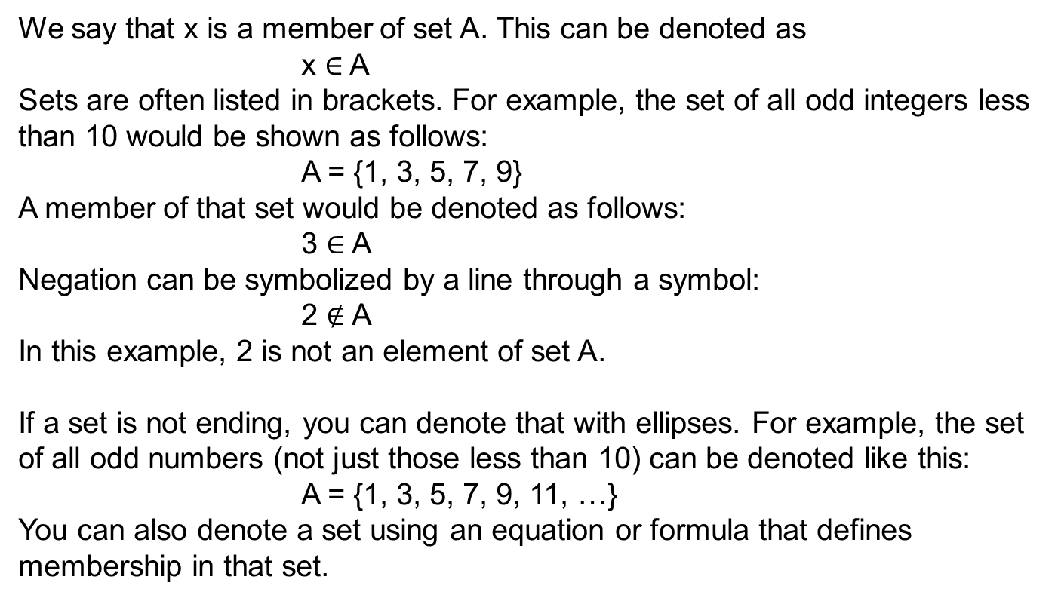
Set Theory

Slide 24
Set Theory
Sets can be related to each other; these are the most common relationships.
Union: With two sets A and B, elements that are members of A, B, or both represent the union of A and B, symbolized as A _ B.
Intersection: With two sets A and B, elements that are in both A and B are the intersection of sets A and B, symbolized as A _ B. If the intersection of set A and B is empty (that is, the two sets have no elements in common), the two sets are said to be disjoint, or mutually exclusive.
Difference: With two sets A and B, elements that are in one set but not both are the difference between A and B, symbolized as A \ B.
Complement: With two sets A and B, set B is the complement of set A if B has no elements that are also in A, symbolized as B = Ac.
Double complement: The complement of a set’s complement is that set itself. In other words, the complement of Ac is A. That may seem odd at first read, but reflect on the definition of the complement of a set for just a moment. The complement of a set has no elements in that set. So it stands to reason that to be the complement of the complement of a set, you would have to have all elements within the set.

Slide 25
Set Theory
A few facts about sets:
Order is irrelevant: {1, 2, 3} is the same as {3, 2, 1} or {3, 1, 2} or {2, 1, 3}.
Subsets: Set A could be a subset of set B. For example, if set A is the set of all odd numbers < 10 and set B is the set of all odd numbers < 100, then set A is a subset of set B. This is symbolized as A _ B.
Power set: Sets may have subsets. For example, set A is all integers < 10, and set B is a subset of A with all prime numbers < 10. Set C is a subset of A with all odd numbers < 10. Set D is a subset of A with all even numbers < 10. We could continue this exercise making arbitrary subsets such as E = {4, 7}, F = {1, 2, 3}, and so on. The set of all subsets of a given set is called the power set for that set.

Slide 26
Logic
Axiom: An axiom is something assumed to be true. Essentially one has to start from somewhere. Now you could, like the philosopher Descartes, begin with “I think, therefore I am” (e cogito ergo sum), but that would not be practical for most mathematical purposes. So we begin with some axiom that is true by definition. For example, any integer that is evenly divisible only by itself and 1 is considered to be prime. That is an axiom. Another word for axiom is premise.
Statement: This is a simple statement that something is true. For example, “3 is a prime number” is a statement, “16 is 3 cubed” is a statement.
Argument: An argument is a sequence of statements. Some of these statements, the premises, are assumed to be true and serve as a basis for accepting another statement of the argument, called the conclusion.
Proposition: This is the most basic of statements. For example, if I tell you that I am either male or female, that is a proposition. If I then tell you I am not female, that is yet another proposition. If you follow these two propositions, you arrive at the conclusion that I am male. A proposition is a statement that is either true or not. Some statements have no truth value and therefore cannot be propositions. For example “Stop doing that!” does not have a truth value and therefore is not a proposition.

Slide 27
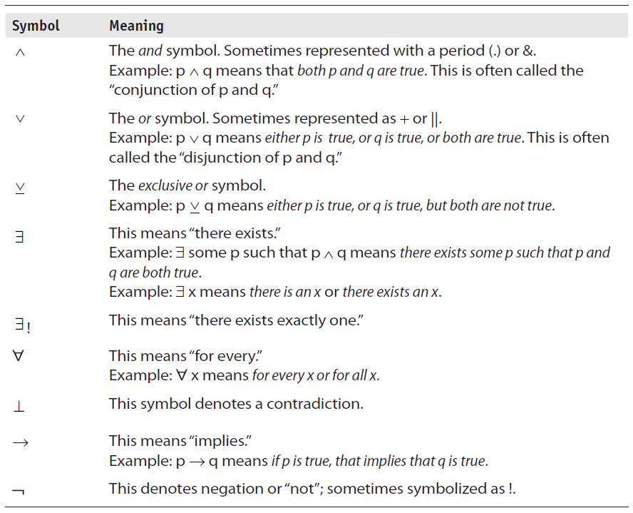
Logic

Slide 28
Logic
Connective | Interpretation
¬ | negation ¬p is true if and only if p is false
∧ | A conjunction p∧q is true if and only if both p and q are true
∨ | A disjunction p∨q is true if and only if p is true or q is true
⇒ | An implication p ⇒ q is false if and only if p is true and q is false

Slide 29
Logic
p: John is an amateur.
q: Paul is an amateur.
r: Paul has a better chance of winning the golf game.
s: John has significant golf experience.
We can now phrase this in symbols:
    (p ∧ q) ∧ r ∧ s
This sort of sentence does not lend itself easily to deducing truth, but it does give us an example of how to rephrase a sentence using logical symbols.

Slide 30
Logic: Truth Tables
p | q | p ∧ q
T | T | T
T | F | F
F | T | F
F | F | F

Slide 31
Combinatorics
Combinatorics is exactly what the name suggests: it is the mathematics behind how you can combine various sets.
Combinatorics answers questions such as these: How many different ways can you choose from four colors to paint six rooms? How many different ways can you arrange four flower pots?
Combinatorics, at least in crude form, is very old.

Slide 32
Combinatorics
The multiplication rule:
Assume there is a sequence of r events and that we will call the events E1, E2, and so on.
There are n ways in which a specific event can occur. The number of ways an event occurs does not depend on the previous event. This means we must multiply the possible events.
In this example, the event is selecting one student, regardless of major. So we might select one from computer science or we might select one from other.
The multiplication rule is sometimes called the rule of sequential counting.

Slide 33
Combinatorics
The addition rule:
Now suppose there are r events E1, E2, and so on, such that there are n possible outcomes for a given event, but further assume that no two events can occur simultaneously. This means we will use the addition rule.
The addition rule is also sometimes called the rule of disjunctive counting. The reason for this name is that the addition rule (also called the sum rule) states that if set A and set B are disjoint sets, then addition is used.

Slide 34
Combinatorics
Permutations are ordered arrangements of things. Because order is taken into consideration, permutations that contain the same elements but in different orders are considered to be distinct. When a permutation contains only some of the elements in a given set, it is called an r-permutation. What this means for combinatorics is that the order of the elements in the set matters. Consider the set { a, b, c}. How many ways can you combine these elements if order matters?
        a b c; a c b; b a c; b c a; c a b; c b a
There are six ways to combine this set, if order matters. If you add one more letter (d), then there are 24 combinations:
        abcd acbd bcad bacd cabd cbad
        abdc acdb bcda badc cadb cbda
        adbc adcb bdca bdac cdab cdba
        dabc dacb dbca dbac dcab dcba
Fortunately you don’t have to write out the possibilities each time to determine how many combinations of a given permutation there are. The answer is n! For those not familiar with this symbol, it is the factorial symbol. It means n × n − 1 × n − 2 × n − 3 and so on. For example, 4 ! is 4 × 3 × 2 × 1.

Slide 35
Graph Theory
Graph theory is an important part of discrete mathematics. It is a way to examine objects and the relationship between those objects mathematically . Put formally, a finite graph G(V, E) is a pair (V, E), where V is a finite set and E is a binary relation on V.
Now let’s examine that definition in more reader-friendly terms. A graph starts with vertices or nodes, what I previously referred to as objects. These objects can be anything. The edges are simply lines that show the connection between the vertices. The edges are ordered pairs and not necessarily symmetrical. In other words, the connection between two vertices may or may not be one-way.

Slide 36
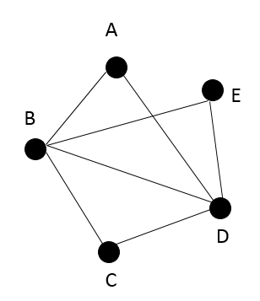
Graph Theory

Slide 37
Graph Theory
Degree of a vertex: Number of edges incident to the vertex. Nodes of a digraph can also be said to have an in degree and an out degree. The in degree is an edge pointing toward the vertex. The out degree is an edge pointing away. You saw this in Figure 4-8.
Adjacency: Two vertices connected by an edge are adjacent.
Directed graph: In a directed graph, often called a digraph, the edges have a direction.
Weighted digraph: This is a directed graph that has a “cost” or “weight” associated with each edge. In other words, some edges (that is, some relationships) are stronger than others.
A complete graph: This graph has an edge between each pair of vertices. N nodes will mean N × (N – 1) edges.

Slide 38
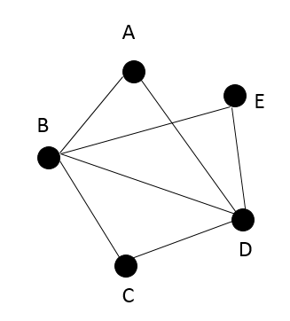
Graph Theory
There are three basic ways you can traverse a graph:
Path: With a path, no vertex can be repeated: for example, a-b-c-d-e. You can repeat an edge if you want, but not a vertex.
Trail: A trail is the opposite of a path. No edge can be repeated: for example, a-b-c-d-e-b-d.
Walk: There are no restrictions: for example, a-b-e-d-b-c.

Slide 39
Graph Theory
There are two special types of traversals:
Circuit: A closed trail (example: a-b-c-d-b-e-d-a)
Cycle: Closed path (example: a-b-c-d-a)
This leads to a few other terms:
Acyclic: A graph wherein there are no cycles
Tree: A connected, acyclic graph
Rooted tree: A tree with a “root” or “distinguished” vertex; the leaves are the terminal nodes in a rooted tree
Directed acyclic graph (DAG): A digraph with no cycles

